Slide 1
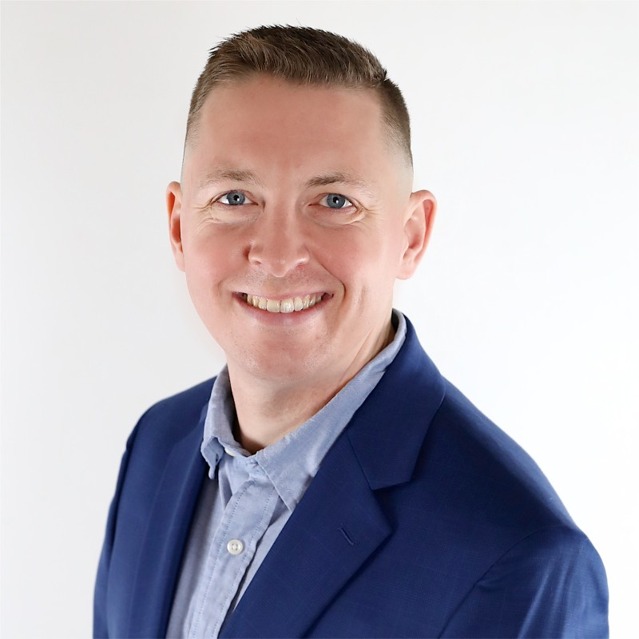
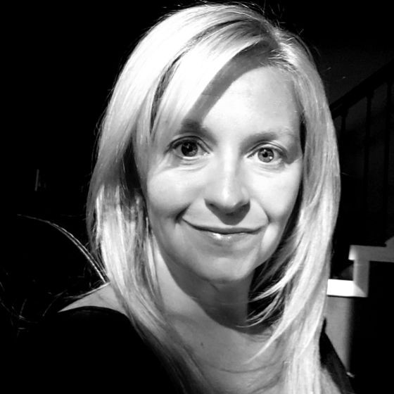
Veterinary Business Institute
Veterinary Talent Solutions Panel
Webinar Title: The Workforce Crisis: Real Strategies to Recruit, Retain, and Rebuild Veterinary Teams
Notes:
"Good evening everyone, and welcome to the Veterinary Talent Solutions Panel , brought to you by the Veterinary Business Institute. Tonight's webinar is titled: 'The Workforce Crisis: Real Strategies to Recruit, Retain, and Rebuild Veterinary Teams'. I am Adeesha Pemananda ., and I'll be your host and moderator for this session."

Slide 2

Platinum Sponsor – Ekwa Marketing
Our Platinum Sponsor, Ekwa Marketing, believes that great veterinary care deserves great visibility. For over 15 years, they’ve helped veterinary practices across USA, UK, Canada, Australia, Ireland & New Zealand connect with pet owners through expert SEO, dynamic social media campaigns, website design and strategic online marketing tailored specifically for the animal health industry. By leveraging data-driven insights and innovative digital tools, Ekwa Marketing empowers clinics to attract new clients, strengthen community relationships, and grow sustainably.
Learn More About Ekwa: www.ekwa.com
Notes:
And this essential conversation is made possible by our wonderful sponsor, Ekwa Marketing. In today's digital world, building a practice that truly connects with your community and drives growth requires a clear, strategic marketing plan. Ekwa Marketing specializes in helping veterinary practices do just that, and they've got a special thank you for you later that you don't want to miss.

Slide 3

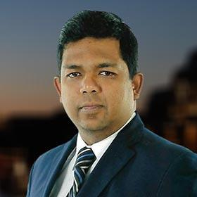
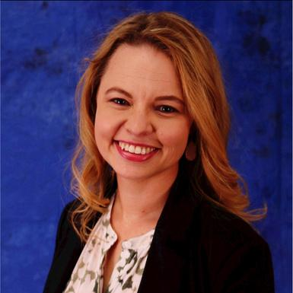
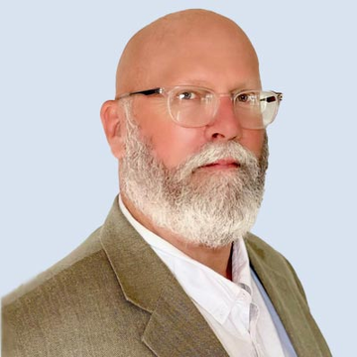
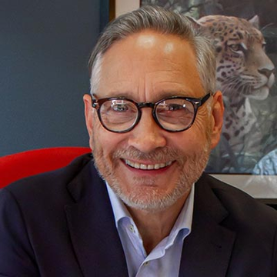
Veterinary Business Podcast
Every Thursday @ 5:00 AM ET
What Do We Cover:
Practice Management
Financial Management
Marketing and Branding
Technology and Innovation
Industry Trends and Insights
Staff Training and Development
Legal and Regulatory Compliance
Client Experience and Satisfaction
Client Communication and Education
Community Engagement and Outreach
Sustainability and Environmental Practice
Ethical Dilemmas and Professional Standards
Naren Arulrajah
Dr. Amanda Landis-Hanna
Dr. Mark Roozen
Dr. Joel Parker
Notes:
The conversation we're having tonight doesn't have to end in an hour. It continues every week on the Veterinary Business Podcast.
Our mission is simple: to bring you actionable business insights from industry leaders to bridge the gap between medicine and management. New episodes drop every Thursday morning at 5 AM Eastern.
Just search for 'Veterinary Business Podcast' wherever you listen, and be sure to subscribe.

Slide 4
Veterinary Business Institute’s
Annual Expert Panel Webinar
Veterinary Talent Solutions Panel: The Workforce Crisis: Real Strategies to Recruit, Retain, and Rebuild Veterinary Teams
Notes:
So without further ado, let's get to know our experts.

Slide 5
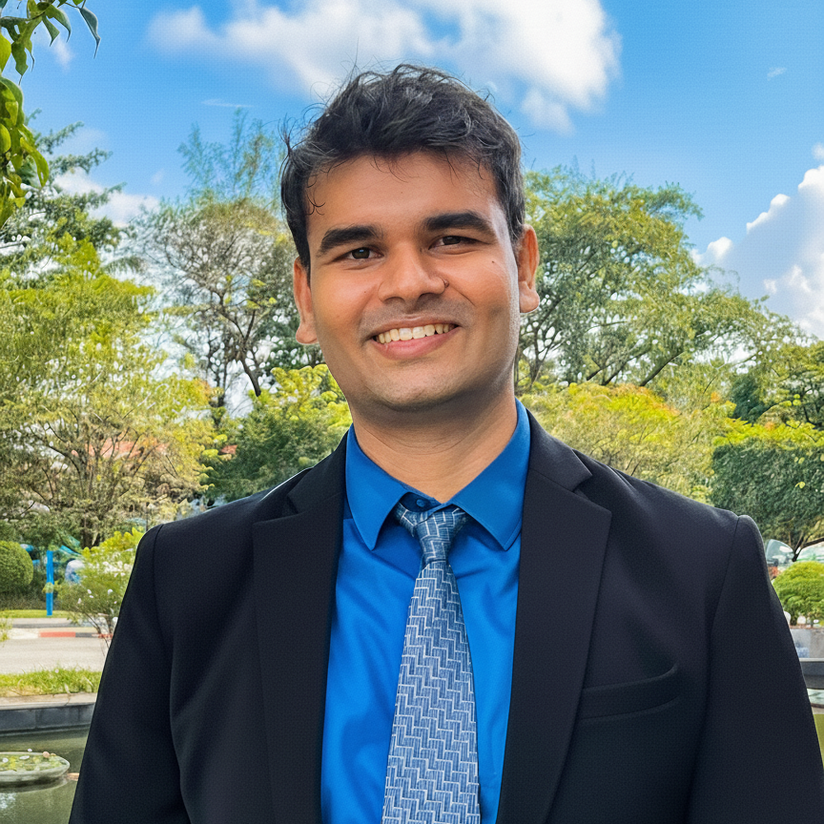
Moderator
Adeesha Pemananda
Senior Executive - Expert Facilitator, Ekwa Marketing
A seasoned marketing professional and a natural on-camera presence, Adeesha Pemananda is a skilled virtual event host and presenter. His extensive experience in brand building and project management provides a unique strategic advantage, allowing him to not only facilitate but also elevate virtual events.
Adeesha is known for his ability to captivate digital audiences, foster interaction, and ensure that the event's core message resonates with every attendee. Whether you're planning a global webinar, an interactive workshop, or a multi-session virtual conference, Adeesha brings the perfect blend of professionalism, energy, and technical savvy to guarantee a successful and impactful event.

Slide 6
Charlotte Weir
Navigating the complex world of veterinary startups? You'll need more than just a map—you'll need a seasoned navigator. With over a decade in the field as an Advisor , VP, and Founder, my forte is in business consulting and developing veterinary startup business plans that work.
Notes:
"First, let's welcome Charlotte Weir. When navigating the complex world of veterinary startups, you need a seasoned navigator. With over a decade in the field as an Advisor, VP, and Founder, Charlotte's forte is in business consulting and developing veterinary startup business plans that work."

Slide 7
Keith True
The opportunities in veterinary medicine go far beyond the exam room! Entrepreneurial opportunities are abundant and exploring this is an interest of mine. The veterinary industry is currently booming, but veterinarians and veterinary staff around the world are struggling. I aim to be the change in the profession and support some of the most caring and passionate people.
Notes:
"Next, we have Keith True. Keith believes the opportunities in veterinary medicine go far beyond the exam room and that entrepreneurial opportunities are abundant. While the industry is booming, he notes that vets and their staff are struggling. He aims to be the change in the profession and support these caring and passionate people."

Slide 8
Main points for today's discussion:
Beyond job postings: creative recruitment strategies that actually work
Reducing burnout through realistic scheduling and workload management
Building career pathways that encourage professional growth
Retention strategies that go beyond paychecks and bonuses
How culture impacts recruitment and long-term loyalty
Notes:
"Here are the main points for our discussion today:
-We'll look beyond job postings for creative recruitment strategies that actually work.
-We'll cover reducing burnout through realistic scheduling and workload management.
-We'll discuss building career pathways that encourage professional growth.
-We'll explore retention strategies that go beyond paychecks and bonuses.
-And finally, we'll discuss how culture impacts recruitment and long-term loyalty. (...Main panel discussion begins...)"

Slide 9


🎉 Thank You for Joining Us Today!
As a token of our appreciation, we’re thrilled to offer you an exclusive gift valued at $900. 🗓️ A Free Marketing Strategy Meeting with Lila Stone, Veterinary Marketing Consultant and Marketing Advisor of Ekwa Marketing & Veterinary Business Institute
Visit https://www.veterinarybusinessinstitute.com/msm/ and Book a Session at your convenience. Lila is Specialized in helping :
General Veterinary Practice
Specialty Veterinary Practice
Emergency and Critical Care Centers
Exotic Animal Practices
Equine Veterinary Practices
Mixed Animal Practices
Holistic Veterinary Practices
Mobile Veterinary Services
Research and Teaching Hospitals
Rehabilitation and Physical Therapy Centers
Notes:
"Charlotte and Keith, thank you for that incredibly timely discussion. And as a token of our appreciation for all of you joining us today, we’re thrilled to offer an exclusive gift valued at $900. It's a Free Marketing Strategy Meeting with Lila Stone, a Veterinary Marketing Consultant for Ekwa Marketing and the Veterinary Business Institute. Lila specializes in helping practices just like yours, from General and Specialty to Mobile and more . Please use the link or scan the QR code to book your session at your convenience."

Slide 10
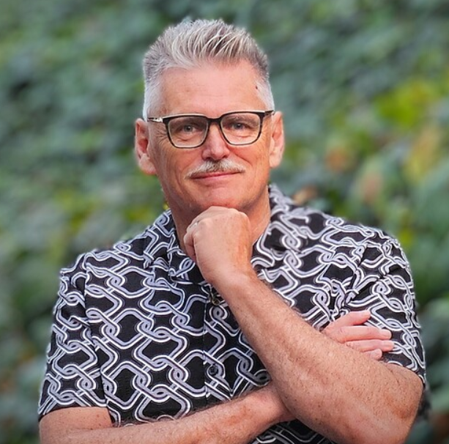
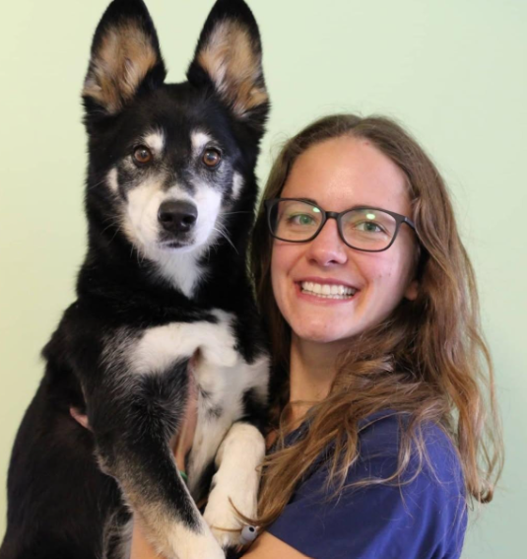
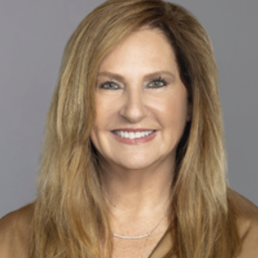
Veterinary Business Institute
Thank You
Notes:
"That is all the time we have for tonight. A huge thank you to our expert panelists, Charlotte Weir and Keith True, for their invaluable insights. And to our wonderful audience, thank you for your time and engagement. On behalf of the entire Veterinary Business Institute, I'm Adeesha Pemananda .. Goodnight, everyone."

